Slide 1
DESN 1000
XD

Slide 2
Problem Statement
fit inside a cylinder 250mm in diameter and 250mm high
Weigh less than 1000 gm
Cost less than $120
OS to be developed on an Arduino Uno microcontroller.
Manoeuvre through a complex maze
Be able to traverse through rough terrain (stairs)
Locate and retrieve the victim (tennis ball)

Slide 3
extend beyond one concept generation technique
The gallery method
6-3-5 brainstorming sessions
mind mapping, concept mapping
Morth chart
criterion weighting

Slide 4
gallery method
team member was given a set amount of time to independently brainstorm and sketch their initial design ideas
gathered to ask questions, offer critiques, and make suggestions about the posted ideas which directed us to the brainstorming technique

Slide 6
brainstorming
generate ideas and solutions in a free-flowing and non-critical environment. The free-flowing nature encouraged creativity and collaboration which were essential for generating innovative concepts.
mind mapping which helped us organise the ideas that were generated. By constructing a visual representation of the concepts and their relationships, highlighting the bigger picture of the robot design.

Slide 7
Design Concept Phase

Slide 8
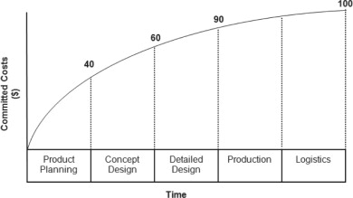
Cost Saving
“90% to 95% of product costs are committed with late design changes” (Georgiou and Haritos, 2012).
1. Design Concept vs. Prototyping and Production
2. Exploring alternatives while minimizing cost
Figure 1. Committed Costs (Georgiou and Haritos, 2012)
Institution of Mechanical Engineers (2012). Sustainable Vehicle Technologies. Elsevier.

Slide 9
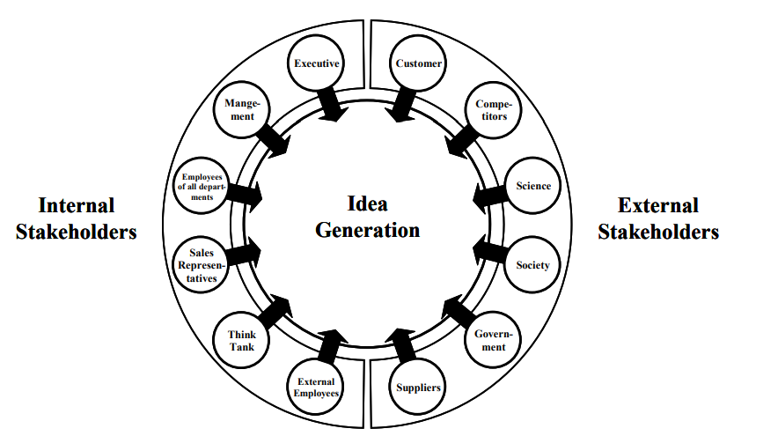
Communication Among Stakeholders
“The success of the product development process heavily depends on the input to the innovation management system that collects, examines, evaluates and selects new concepts and ideas”. - Neumann, Riel, and Brissaud (2011)
Engineers ←→ Management ←→ Investors
Figure 2 Innovation management system based on the integration of stakeholders
Neumann, M., Riel, A. and Brissaud, D. (2011). Sustainable innovation management in the automotive supplier industry. International Journal of Technology Intelligence and Planning, 7(4), p.327. doi:https://doi.org/10.1504/ijtip.2011.045093.

Slide 10
Conclusion
Large walking robots can save lives and improve search and rescue.
They have the potential to find and carry people to safety.
Additionally, they can speed up damage assessment and aid in faster community recovery.

